Slide 1


CS-446: Information Systems Security
Lecture # 10: Digital Signature, Public Key Certificates and Public Key Infrastructure
Prof. Dr. Sufian Hameed
Department of Computer Science
FAST-NUCES

Slide 2
Overview
What will you learn today
Digital Signatures
Public key and Signature
Public Key Infrastructure
Identity Based Encryption

Slide 3
Digital Signature
Authentication and Non-Repudiation
Gives a recipient reason to believe that the message was created by a known sender such that they cannot deny sending it
Integrity
The message was not altered in transit
Notes:
Non-repudiation refers to a state of affairs where the purported maker of a statement will not be able to successfully challenge the validity of the statement or contract

Slide 4
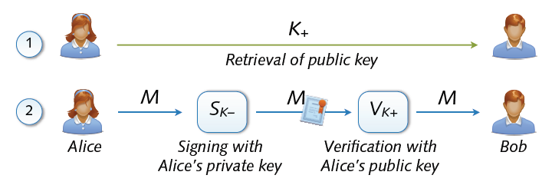
Digital Signature
Digital signing: reverse application of public-key system
Signing = encryption with private key
Verification = decryption with public key

Slide 5
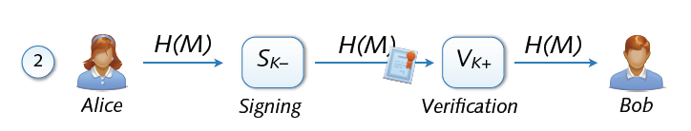
Signing and Hashing
Encryption and decryption of large messages inefficient
Signing of hash H(M) instead of message M
Verification of message M using signed hash H(M)
One-way property: hard to find M’ with H(M’) = H(M)
Support for signing emails, images, videos, ...

Slide 6
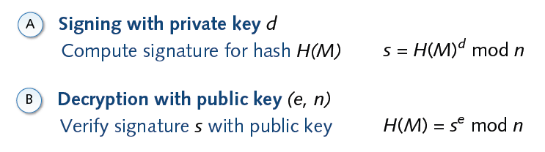
Signature and RSA

Slide 7
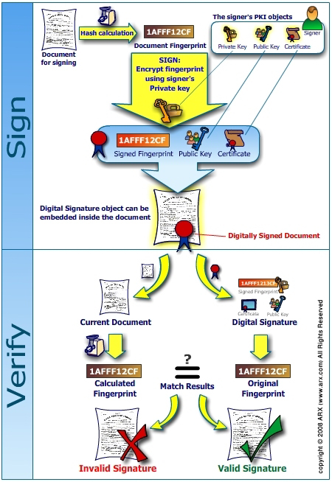
`

Slide 8
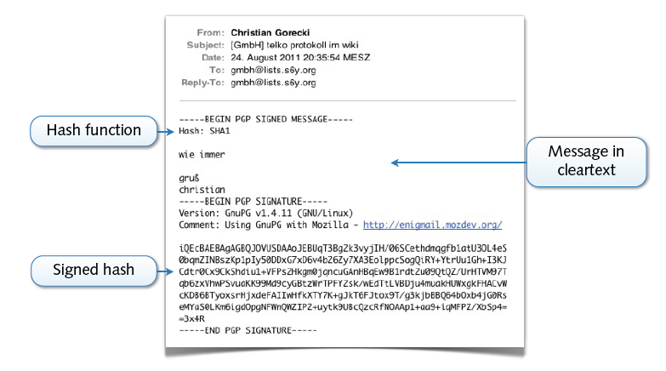
Example: PGP Signature

Slide 9
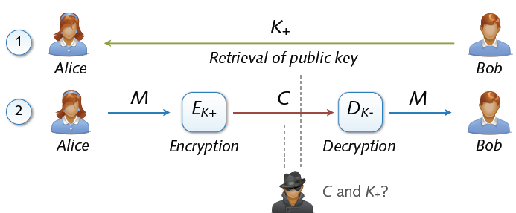
Asymmetric Cryptosystem
Asymmetric cryptosystems
Asymmetric encryption and decryption
K+ (pk) = public key of Bob K– (sk) = secret key of Bob
No secure key exchange necessary

Slide 10
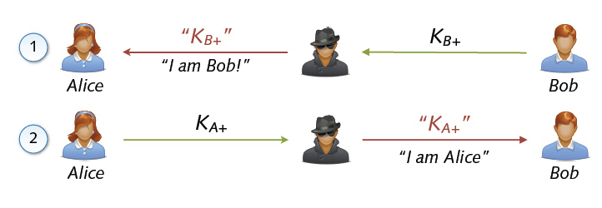
Man in the Middle (MITM)
Common attack against asymmetric cryptosystems
Interception of public key exchange by attacker
Transparent eavesdropping using forged keys

Slide 11
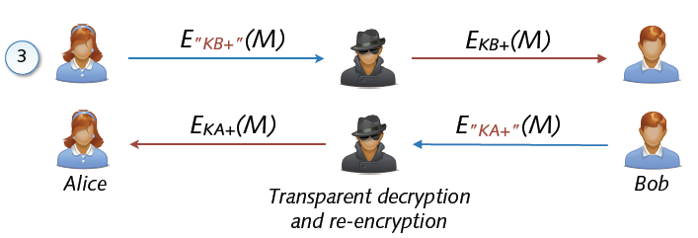
Man in the Middle (MITM)
Attacker invisible to both parties
Received data encrypted with correct public key
Sent data encrypted with forged public keys

Slide 12
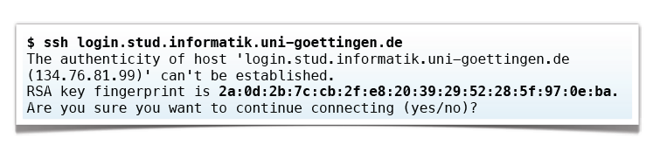
Key Fingerprints
Protection against MITM using key fingerprints
Manual comparison of public keys using hash values
Storage of approved public keys in database
Example: SSH client presents fingerprint for validation
Secure exchange of fingerprints required (hen-egg problem)

Slide 13
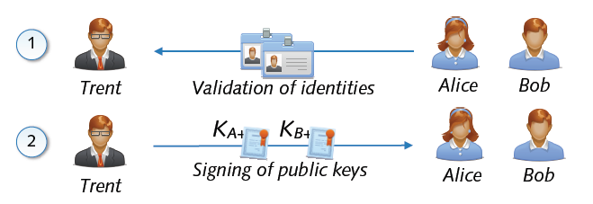
Public Key and Signatures
Problem: Public keys not linked to identity of user
Solution: Validation and signing of public key by third party
Certification of link between identity and public key
Acceptance of signed public keys only → no MITM attack

Slide 14
Public Key Certificates
Electronic document that uses a digital signature to bind a public key with an identity
Information such as the name of a person or an organization, their address, and so forth.
The certificate can be used to verify that a public key belongs to an individual.
Two Types of Signature on a Certificate
In public key infrastructure (PKI) scheme
Signature will be of a certificate authority (CA).
In web of trust scheme
Signature is of either the user (a self-signed certificate) or other users ("endorsements").
In either case, the signatures on a certificate are attestations by the certificate signer that the identity information and the public key belong together.
*from wiki

Slide 15
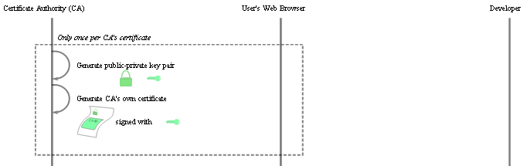
Certificate Creation (Step 1)
*from wiki
Notes:
A random element in Z_N is *very* likely to be in Z_N^*

Slide 16
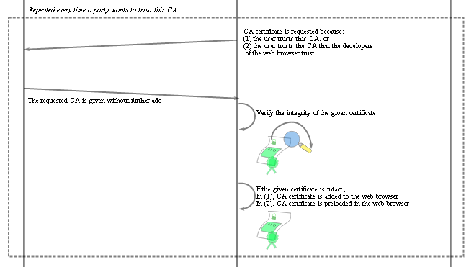
Certificate Creation (Step 2)
*from wiki
Notes:
A random element in Z_N is *very* likely to be in Z_N^*

Slide 17

Certificate Creation (Step 3)
*from wiki
Notes:
A random element in Z_N is *very* likely to be in Z_N^*

Slide 18
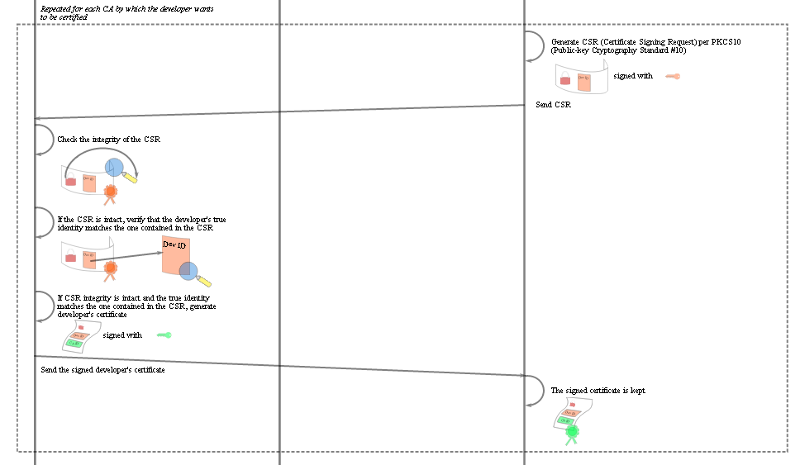
Certificate Creation (Step 4)
*from wiki
Notes:
A random element in Z_N is *very* likely to be in Z_N^*

Slide 19
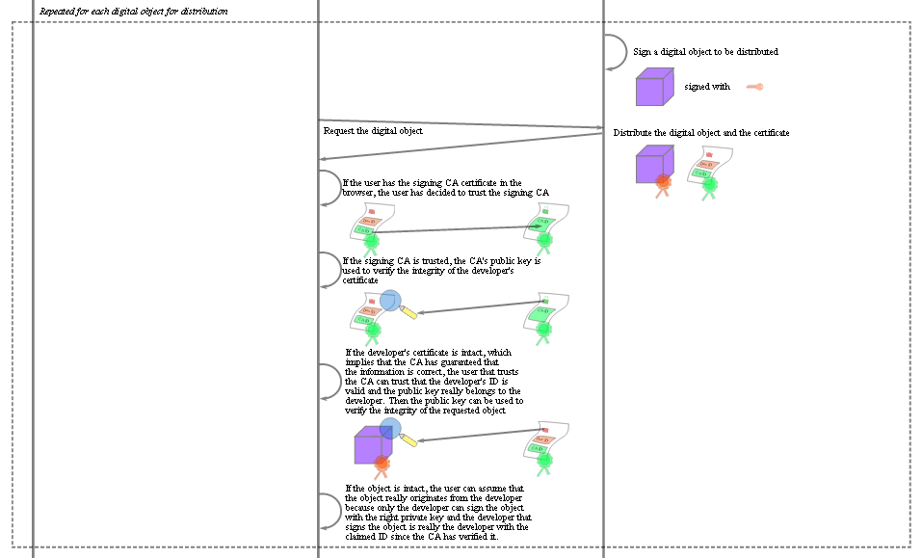
Certificate Creation (Step 5)
*from wiki
Notes:
A random element in Z_N is *very* likely to be in Z_N^*

Slide 20
Contents of Typical Digital Certificate
Serial Number: Used to uniquely identify the certificate.
Subject: The person, or entity identified.
Signature Algorithm: The algorithm used to create the signature.
Signature: The actual signature to verify that it came from the issuer.
Issuer: The entity that verified the information and issued the certificate.
Valid-From: The date the certificate is first valid from.
Valid-To: The expiration date.
Key-Usage: Purpose of the public key (e.g. encipherment, signature, certificate signing...).
Public Key: The public key.
Thumbprint Algorithm: The algorithm used to hash the public key certificate.
Thumbprint: The hash itself, used as an abbreviated form of the public key certificate.
*from wiki

Slide 21
Vendor defined classes
VeriSign uses the concept of classes for different types of digital certificates
Class 1 for individuals, intended for email.
Class 2 for organizations, for which proof of identity is required.
Class 3 for servers and software signing, for which independent verification and checking of identity and authority is done by the issuing certificate authority.
Class 4 for online business transactions between companies.
Class 5 for private organizations or governmental security.
Other vendors may choose to use different classes or no classes at all as this is not specified in the PKI standards.
*from wiki

Slide 22
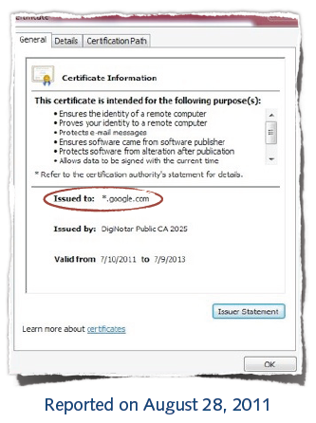
No more MITM?
Case: Forged Google certificate
Issued by legitimate CA
Valid for *.google.com
Used by unknown holder
Reported by Iranian users
Large-scale attack against CA
Break-in at CA DigitNotar
539 forged certificates

Slide 23

Public Key Infrastructure (PKI)
Public-key infrastructure (PKI) is a set of hardware, software, people, policies, and procedures needed to create, manage, distribute, use, store, and revoke digital certificates.
Management of trust using public-key cryptography
Digital certificates (signatures) on keys, attributes, ...
Certificate authorities (CA) as trusted parties
Chain of trust with multiple layers
Different architectures
Hierarchical PKI,
e.g. X.509 standard
Web of trust,
e.g. PGP software

Slide 24
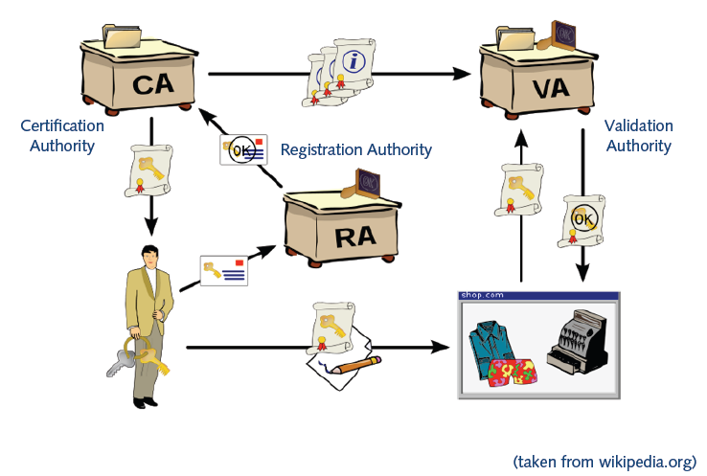
Roles In PKI
*from wiki

Slide 25
Roles In PKI
Certification Authority (CA)
Trusted third party that binds public keys with respective user identities
Validation Authority (VA)
The user identity must be unique within each CA domain. The third-party Validation Authority (VA) can provide this information on behalf of CA.
Registration Authority (RA)
The binding is established through the registration and issuance process, which, depending on the level of assurance the binding has, may be carried out by software at a CA, or under human supervision. The PKI role that assures this binding is called the Registration Authority (RA). The RA ensures that the public key is bound to the individual to which it is assigned in a way that ensures non-repudiation.
*from wiki

Slide 26
Acknowledgements
Material in this lecture are taken from the slides prepared by:
Prof. Dr. Konrad Rieck (Uni-Göttingen)

